Slide 1





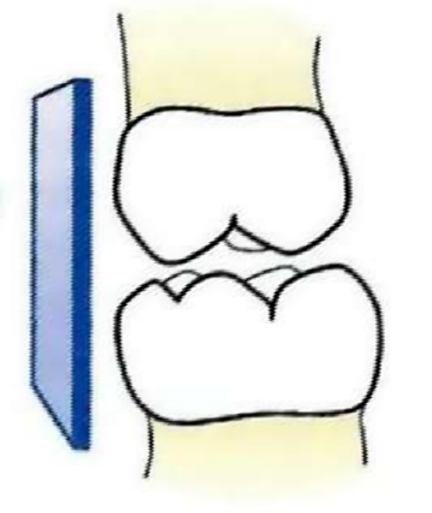
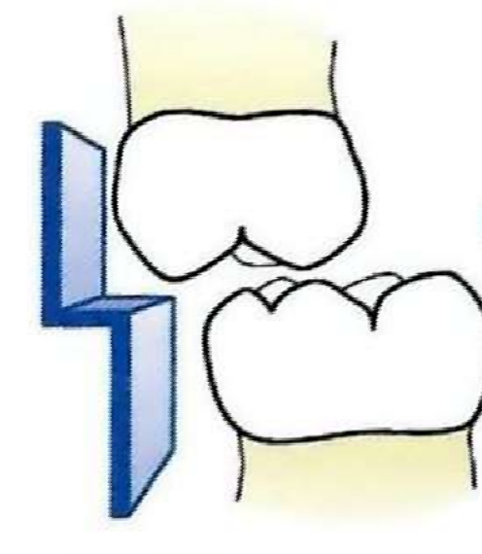
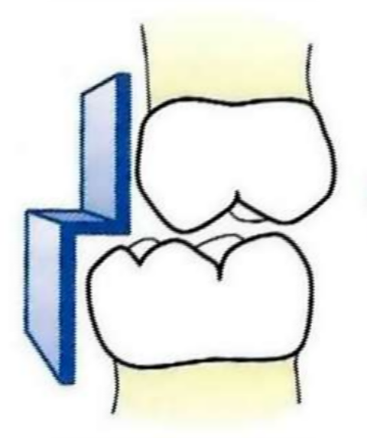



Terminal planes
The molar relationship in the primary dentition can be classified into 3 types:
oStraight/flush terminal plane.
oMesial step terminal plane .
oDistal step terminal plane.

Slide 2
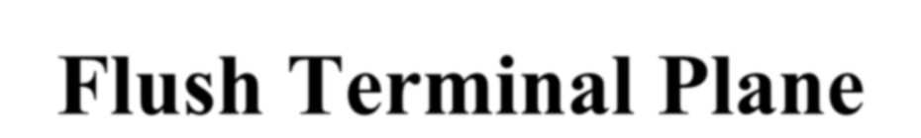

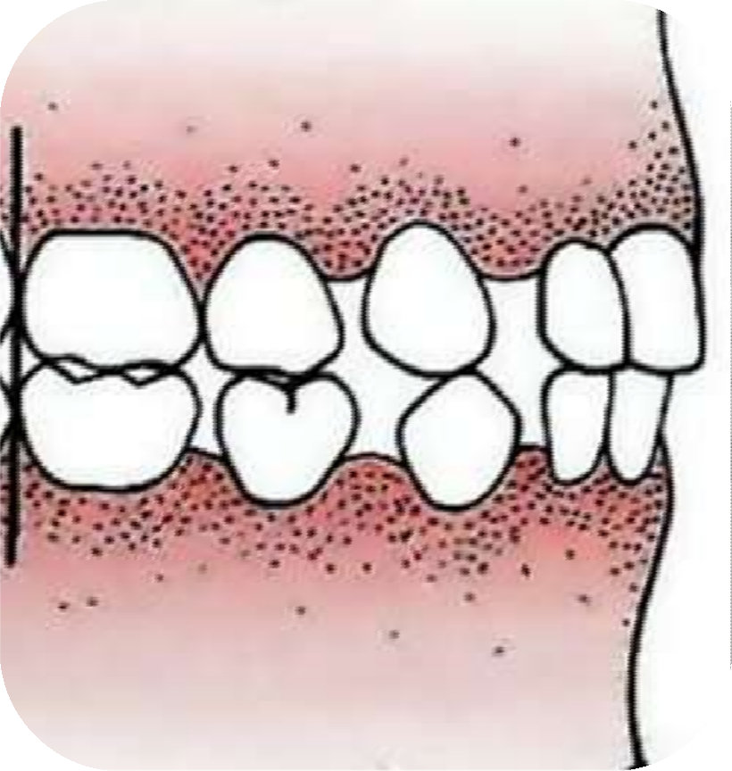

If the distal surface of maxillary and mandibular deciduous second molars are in the same vertical plane
Normal molar relationship in the primary dentition

Slide 3



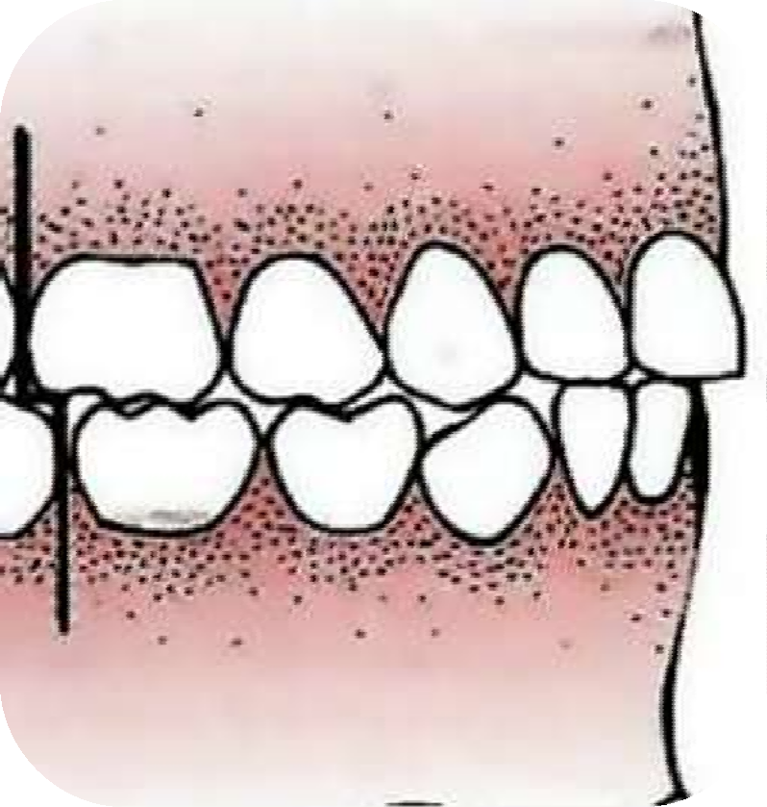

Distal surface of mandibular deciduous second molar is mesial to the distal surface of maxillary deciduous second molar.

Slide 4


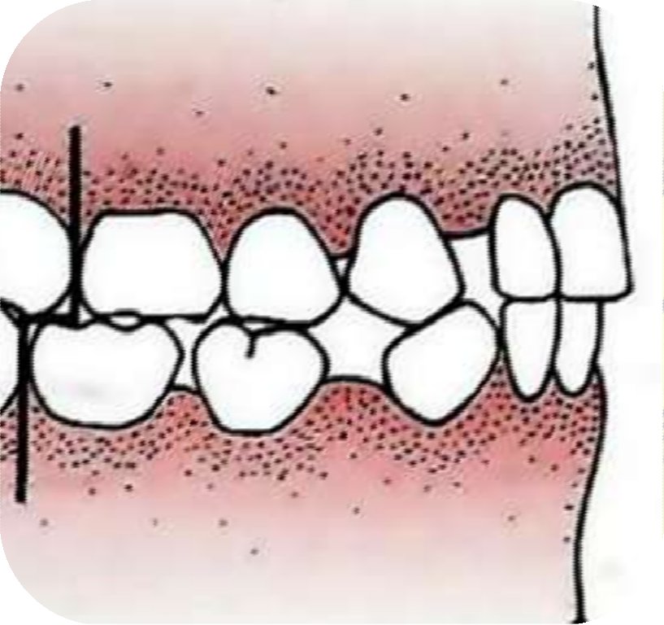

Distal surface of mandibular second deciduous molar is more distal to the distal surface of the maxillary second deciduous molar

Slide 5

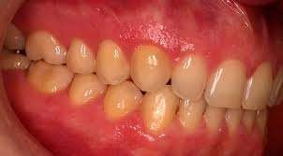
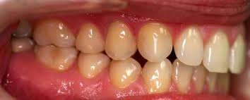
Relationship of maxillary & mandibular deciduous caninnes is one of the most stable in primary dentition
Classified as:
Class 1 - in embressure
Class 2 – distal to embressure
Class 3 – any other relation
Class 1
Class 2

Slide 6




(Around 6 years- 12 years)
The mixed dentition period can be divided into three phases:
First transitional period.
Inter-transitional period.
o Second transitional period.

Slide 7


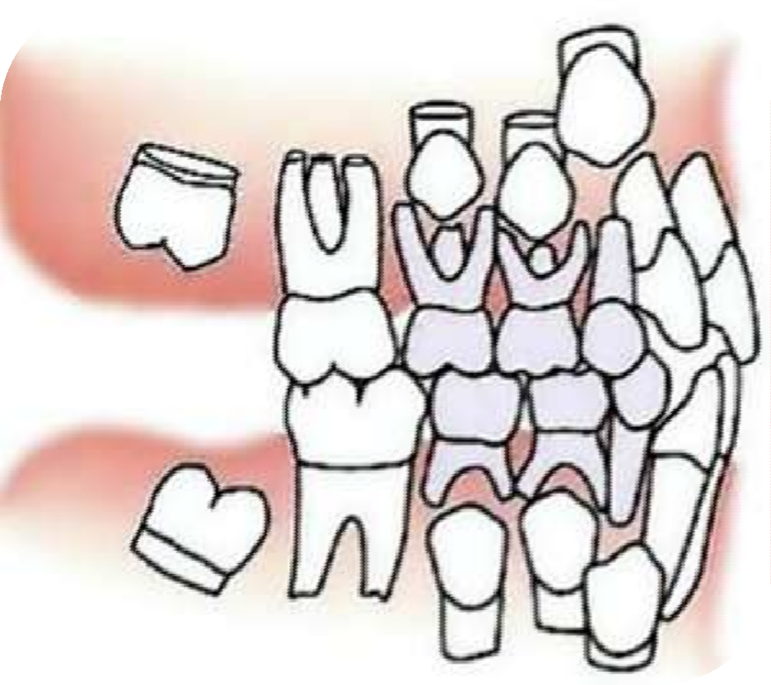


Slide 8


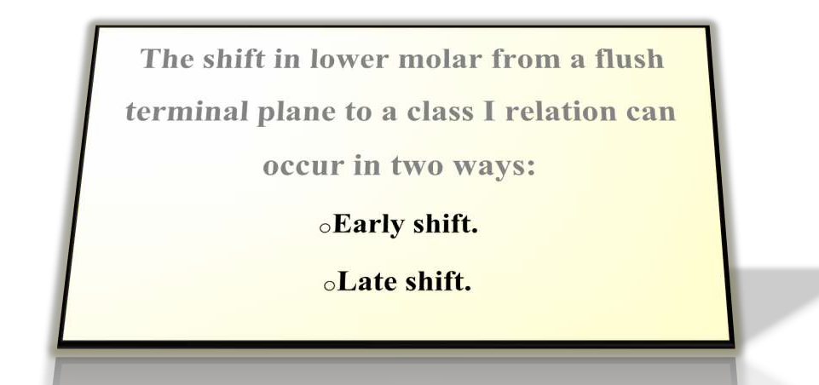

Slide 9
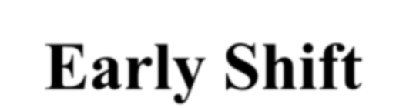

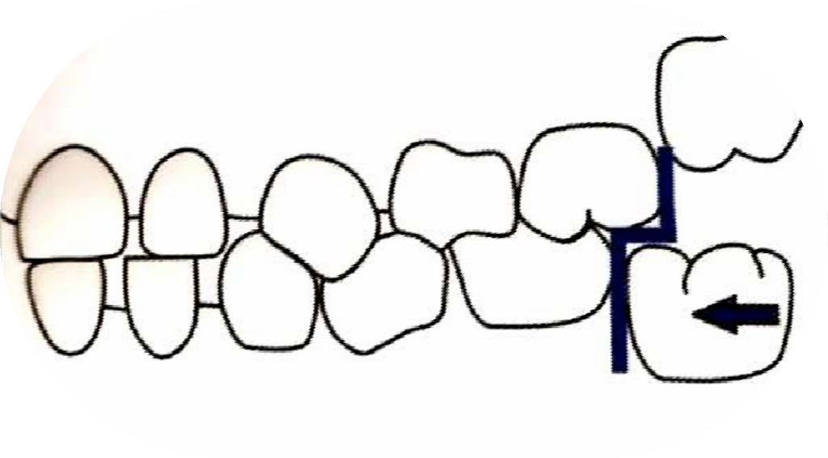

Early shift occurs during the early mixed dentition period.
Since this occurs early in the mixed dentition, it is called early shift.

Slide 10

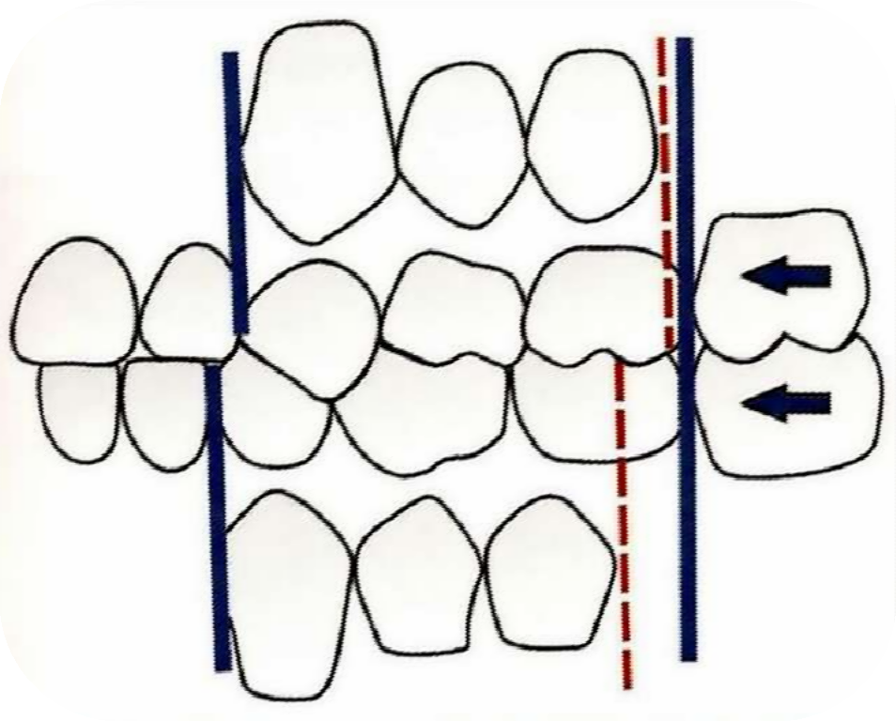


Late Shift
This occurs in the late mixed dentition period and is thus called late shift.

Slide 11


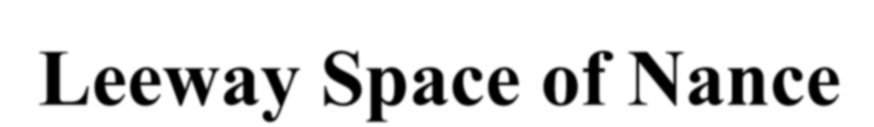

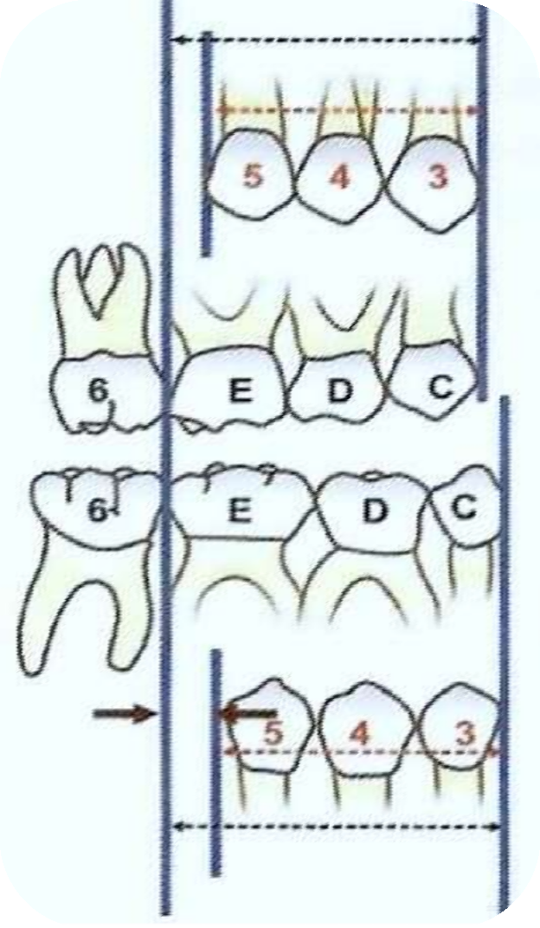

Described by Nance in 1947
Maxilla: 0.9 mm/segment = 1.8 mm.
Mandible: 1.7 mm/segment = 3.4mm.

Slide 12




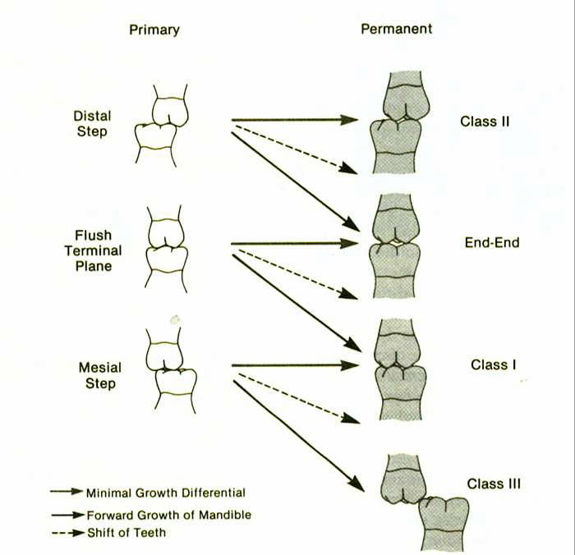
the position of 1st permanent
molar
Distal Step – 23.3% incidence, abnormal, Class II- 38.6%
Straight terminal plane
– 49.2% incidence, Class I
Mesial Step - <2mm
26.7%, class I 58.9%,
>2mm 0.8%. Class III- 2.5%

Slide 13

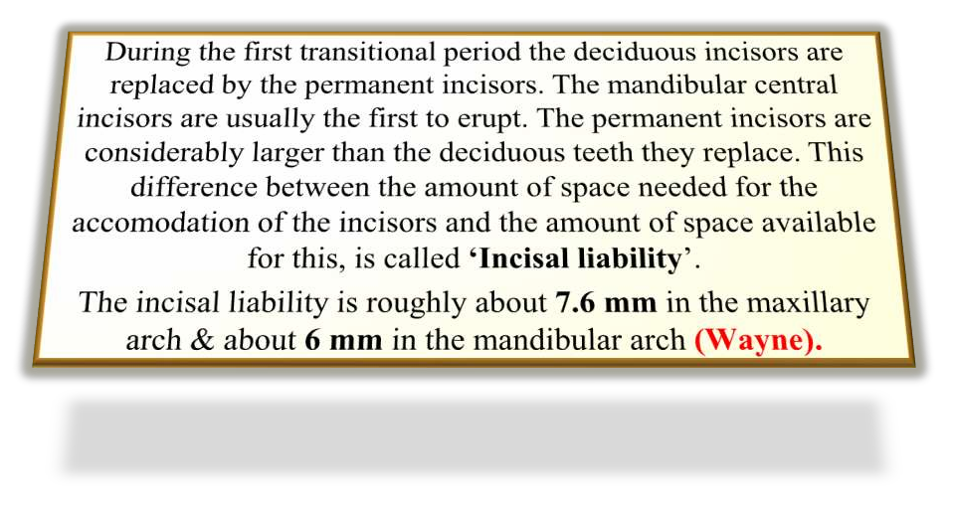

Slide 14


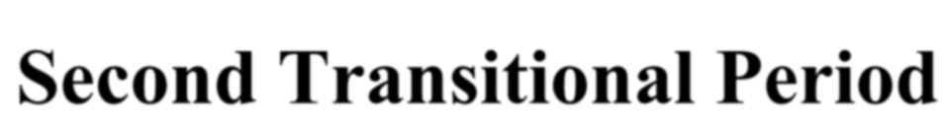
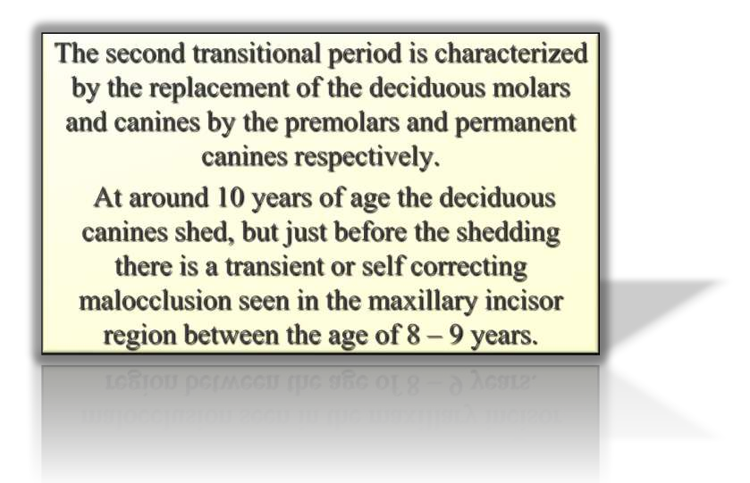

Slide 15



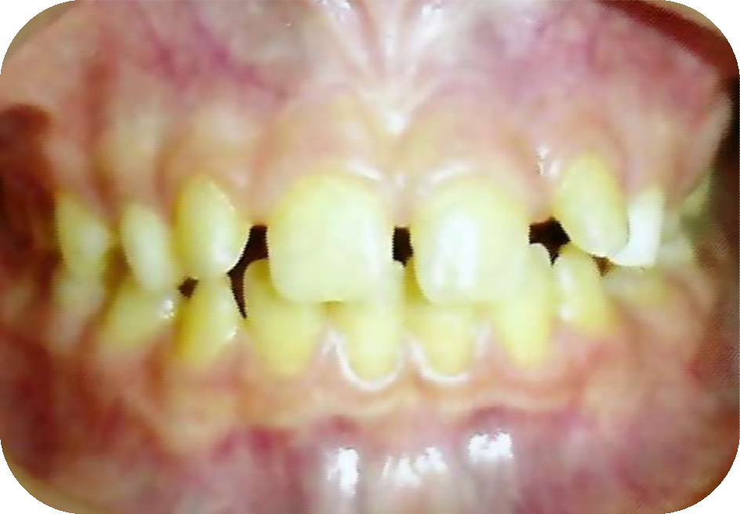

Around the age of 8 - 9 years, a midline diastema is commonly seen in the upper arch, which is usually misinterpreted by the parents as a malocclusion.
Its typical features are: oFlaring of the lateral incisors. oMaxillary midline diastema.

Slide 16




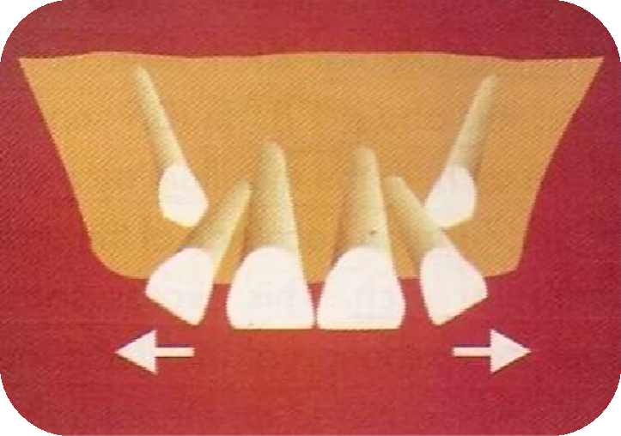


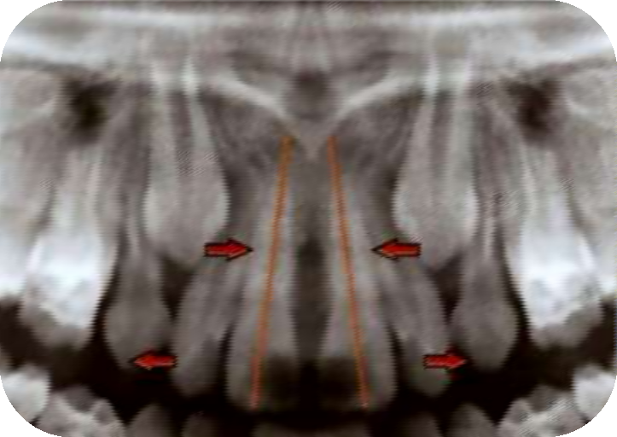

Crowns of canines on young jaws impinge on developing lateral incisor roots, thus driving the roots medially and causing the crowns to flare laterally.

Slide 17




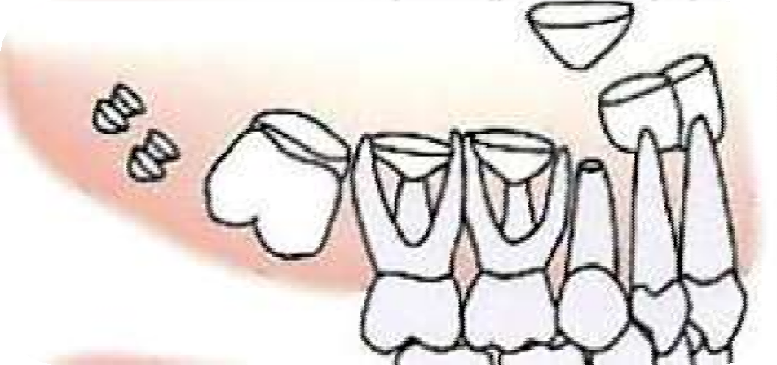


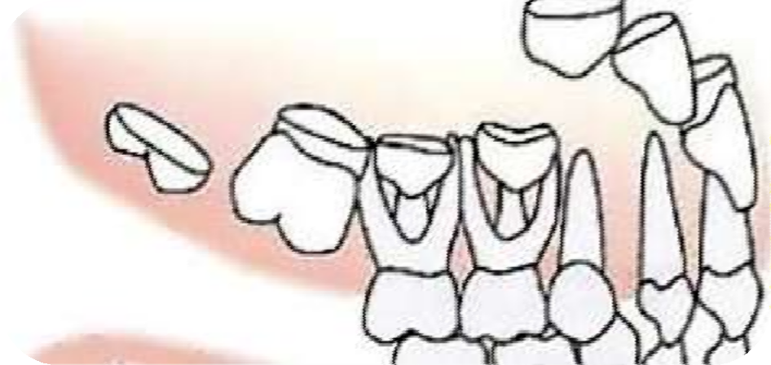

The Permanent Dentition contd…
The permanent incisors develop lingual to the deciduous incisors and move labially as they erupt.

Slide 18
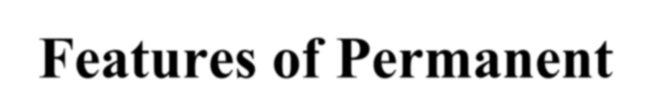
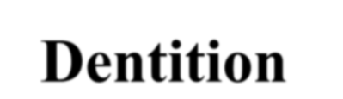



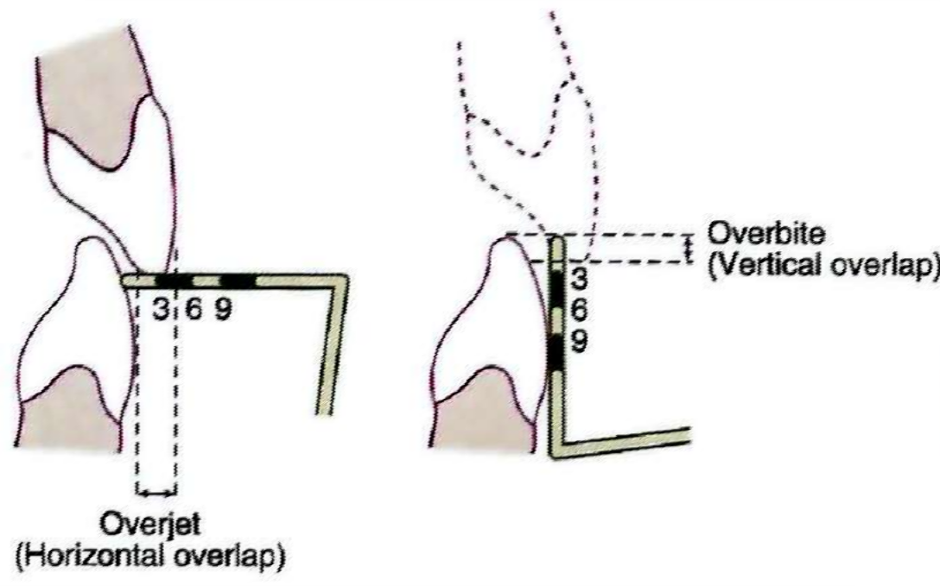

Features of Permanent
Dentition contd…
Overjet and over bite decreases throughout the second decade of life due to greater forward growth of the mandible.

Slide 19


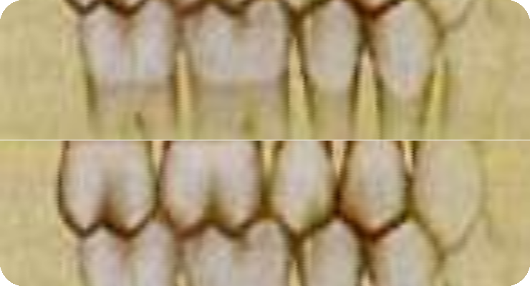

Andrews keys to normal
occlusion
Key I – Molar relationship
MB cusp of the max 1st molar falls into the mesiobuccal groove of the mand 1st molar.
DB cusp of the upper first permanent molar occlude with mesial surface of the MB cusp of the lower second molar.

Slide 20
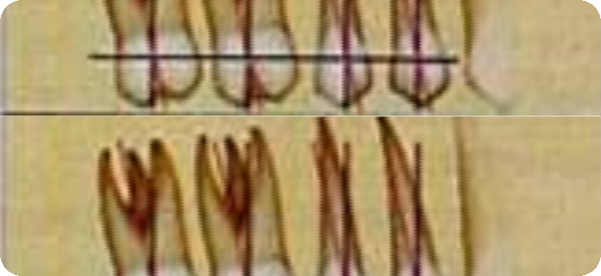
occlusion
Key II Crown angulation
The gingival portion of the long axis of the all crowns must be distal to the occlusal part of axis.

Slide 21
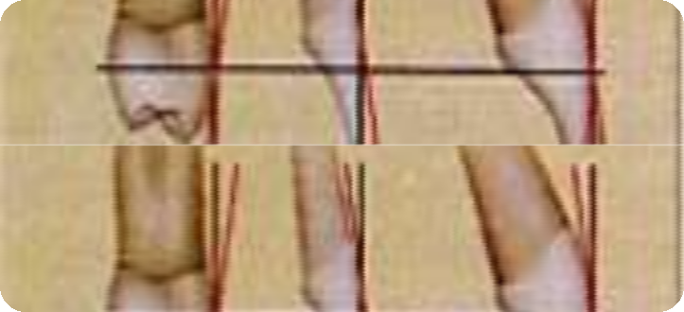
Andrews keys to normal
occlusion
Key III Crown inclination
In upper incisors, the gingival
portion of the crowns labial surface is lingual to the incisal portion.
In all other crowns, including lower incisors, the gingival portion of the labial or buccal surface is labial or buccal to the incisal or occlusal portion.

Slide 22



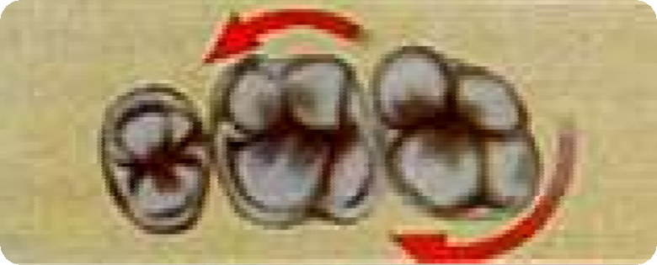
Andrews keys to normal
occlusion
Key IV – Rotations
The fourth key to normal occlusion is that the teeth should be free of undesirable rotations.

Slide 23
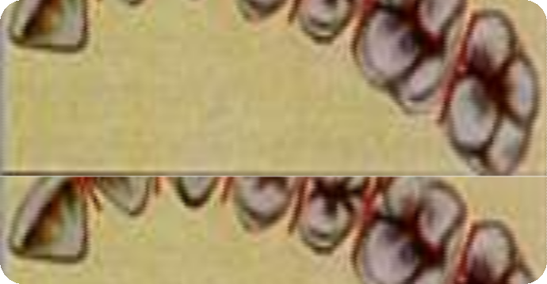
Andrews keys to normal
occlusion
Key V – Tight contacts
contact points should be tight (no spaces).
In absence of abnormalities such as genuine tooth size discrepancies, contact point should be tight.

Slide 24

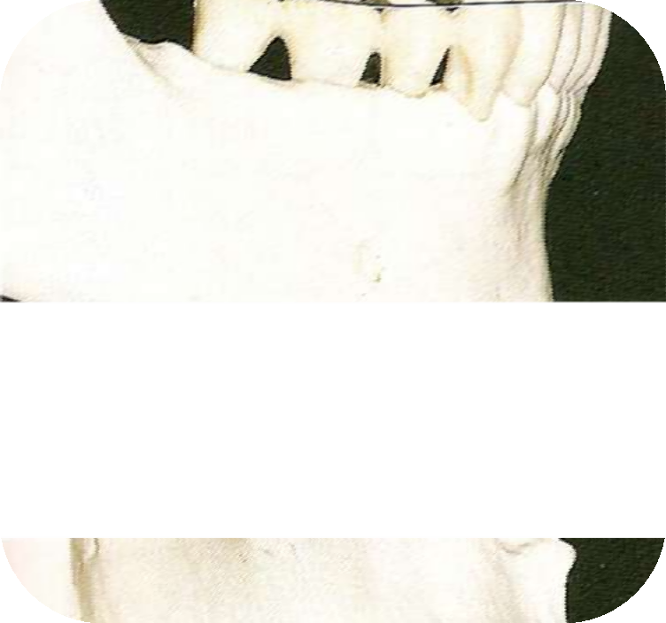

Andrews keys to normal
occlusion
Key VI – Occlusal plane or curve
of spee
The curve of Spee should have no more than a slight arch.
Intercuspation of teeth is best when the plane of occlusion is relatively flat.

Slide 25
Take Away Home Message
The alveolar process at the time of birth is called gum pads.
Lateral sulcus is the transverse groove between canine and 1st molar.
Delabarre in 1918 was the fisrt to describe interdental spacing in primary dentition.
Andrew’s 6 keys of occlusion for permanent teeth are molar interarch relationship , mesiodistal crown angulation,labiolingual crown inclination ,tight contacts,curve of spee and boltons discrepancy.

Slide 26


References
Handbook of Orthodontics: Robert E. Moyers.
Orthodontics the art & science: S. I. Bhalajhi.
Textbook of Orthodontics: M.S. Rani.
Textbook of Pediatric Dentistry: S.G. Damle.
Dental Anatomy, Physiology & Occlusion: Wheeler.
Textbook of Pedodontics: Shoba Tandon.
Textbook of Orthodontics: Samir E. Bishara.
Contemporary orthodontics –Proffit
Textbook of Pedodontics: Koch.
Orthodontics principles and practice: T. M. Graber.

